Slide 1
Many things in nature would remain stationary unless some other factors are present which would cause them to move.
For example:
Let’s consider the following set-up. Would water flow from Tank A to Tank B or vice versa when the tap is opened?
Tank A
Tank B
Tap
How about in the set-up below? Would water flow from Tank A to Tank B when the tap is opened?
Tank A
Tank B
Tap
Notes:
Qns facilitators can ask:
What is the factor that cause water to move from one tank to the other?
If water level in Tank B is increased, how would the flow be affected?

Slide 2
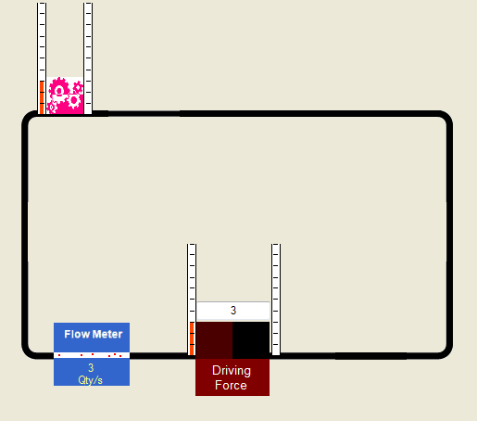
Today, we will be exploring something similar…
Run Arrangement1.exe from LEO.
Pink device
Bar height
Connecting lines
Bar height
Driver
In Arrangement1.exe, we have a driver which creates a flow through the connecting lines and the pink device. This flow is measured by the blue flow meter. The bar height measures a quantity on both sides of the pink device and the driver.
Notes:
Qns facilitators can ask:
1) Relate this set-up to the previous example with Tank A and Tank B.

Slide 3
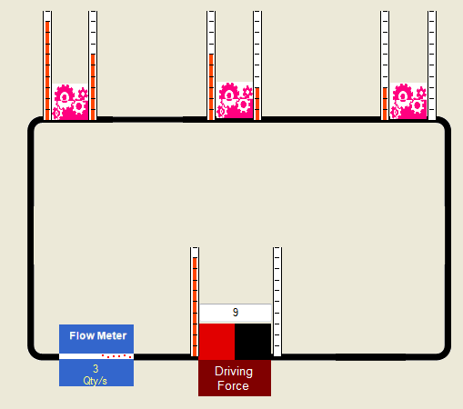
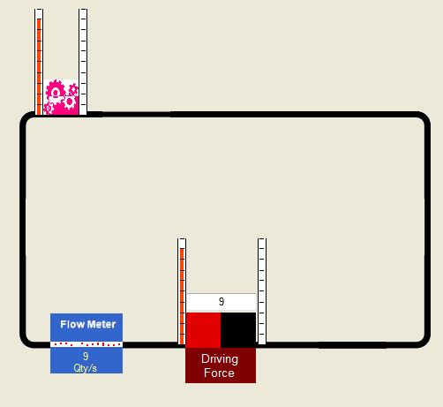
If we change the number of devices while keeping the same driving force, we will observe a different outcome.
3 pink devices
1 pink device
Notes:
Ask:
What difference do you see in the reading on the flow meters in the two arrangements?
What difference do you notice about the bar heights across the driver and across each pink device in the two arrangement?

Slide 4
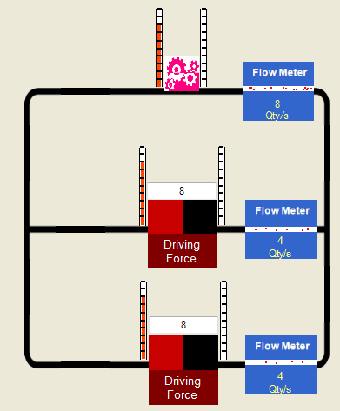
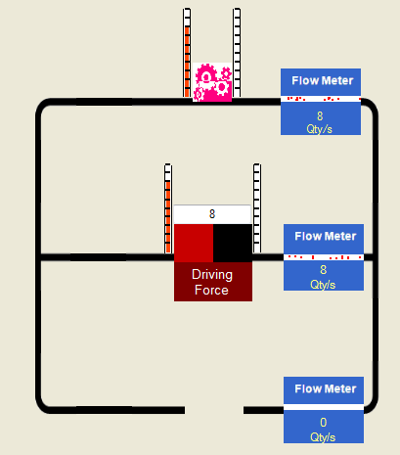
If we change the number of drivers, we will observe a different outcome, even if the driving force provided by each driver remains the same.
2 drivers
1 driver

Slide 5
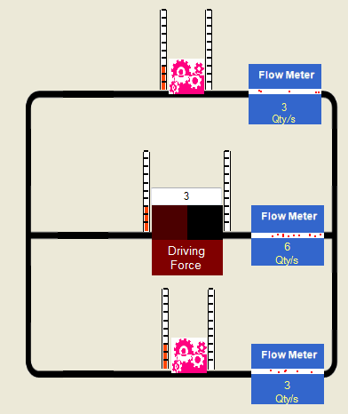
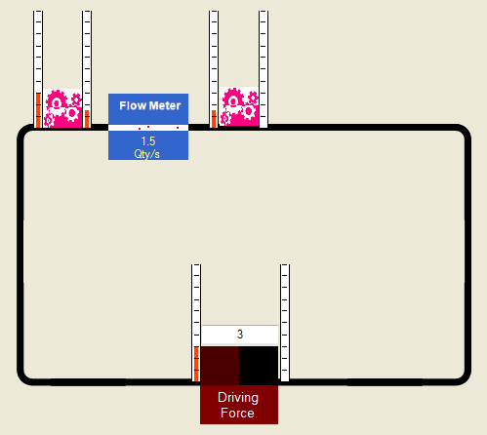
The same number of devices and drivers when arranged differently, can give different outcomes.

Slide 6
Your challenge for the day
Make observations about the phenomena shown in the programs for the various arrangements and make suitable deductions.
Explain how the drivers and devices affect the driving force, bar heights and flow for the various arrangements.
Apply your understanding to predict the outcomes for other arrangements.

